Slide 1
DEMO details
This is just a sample demo to showcase the offline capability of fetching the corresponding place name from a set of latitude and longitude. At the moment, only a sample script has been developed with no UI. The average fetch time takes over 40 seconds though there is immense scope for performance optimization.

Slide 2
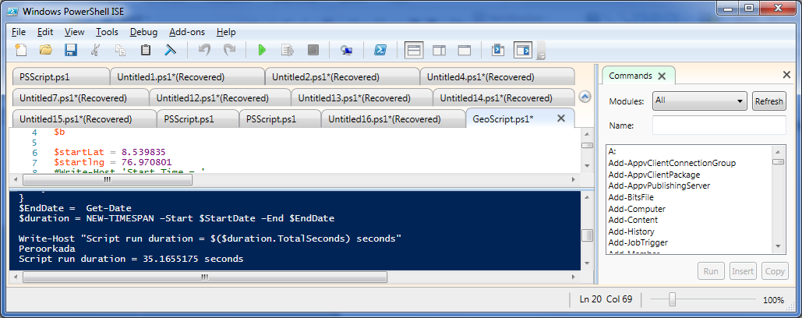
Select a latitude and longitude from google maps or any other gps based app.
A few samples like.
8.539835, 76.970801 - Peroorkada

Slide 3
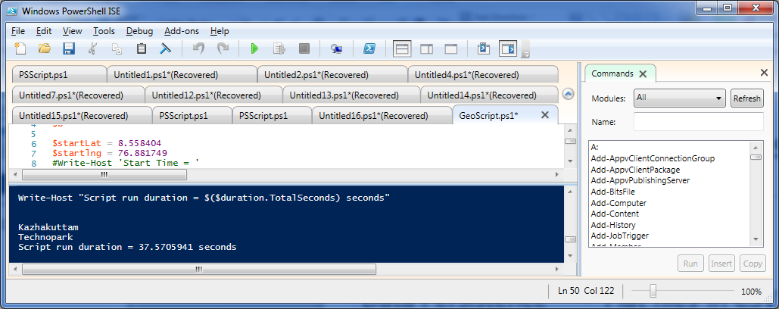
2. Technopark - 8.558404,76.881749

Slide 4
POC Specifications
Scripting Language – Powershell
IDE - Powershell IDE
Data Persistence - Flat files in CSV format
UI - No UI created.
Formulae Used - Haversine
Operating System - Windows
Memory Requirement – 2 GB free RAM

